Slide 1

ALY 6000 Module 1 Project - Executive Summary Report - Part 1 Assignment 1
Sunil Raj THOTA NUID: 001099670

Slide 2
Introduction
There were a record 44.8 million immigrants living in the U.S. in 2018, making up 13.7% of the nation’s population. This represents a more than fourfold increase since 1960, when 9.7 million immigrants lived in the U.S., accounting for 5.4% of the total U.S. population.
Descriptive statistics are used to describe the basic features of the data in a study. They provide simple summaries about the sample and the measures. Together with simple graphics analysis, they form the basis of virtually every quantitative analysis of data.
Data visualization means presenting raw data through graphical representations that allow viewers—business analysts and executives—to explore the data and uncover deep insights
This assignment’s main purpose is to dive deep into the basics of Analytics and Descriptive Statistics

Slide 3
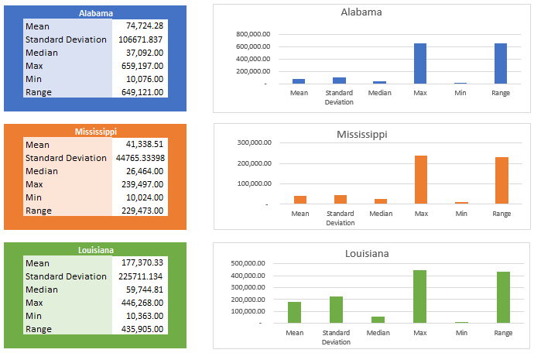
Basic Descriptive Statistics
Here is the basic descriptive stats comparison of 3 states i.e., Alabama, Mississippi, and Louisiana
The average (mean) of Louisiana is greater than the other two states combined
The minimum of population in all these three states is approximately similar
The maximum of population of Alabama is greater than the other two states combined

Slide 4
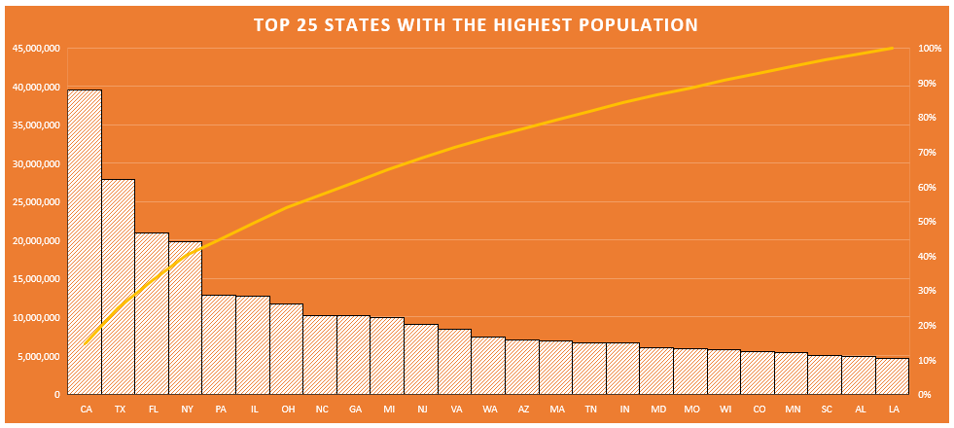
Pareto Chart
The Pareto chart indicating the top 25 most populous US states
Bars indicate descending order of population in millions, line graph indicates cumulative percentage.

Slide 5
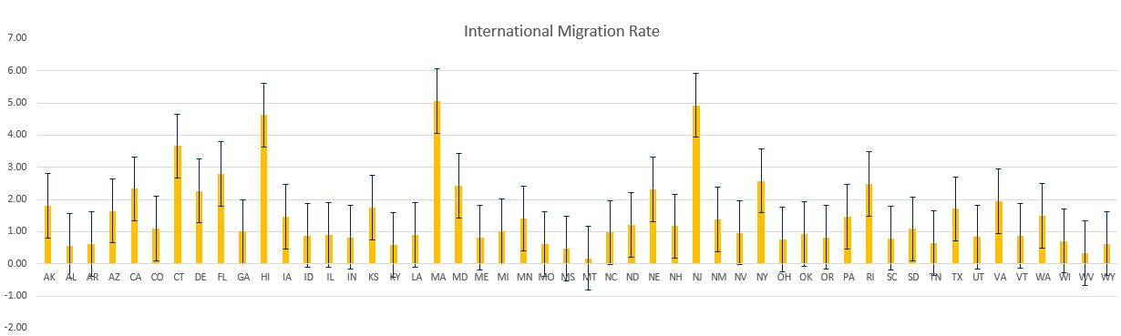
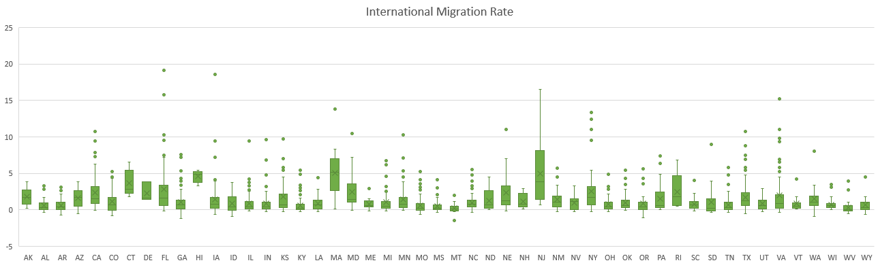
IMR Bar Graph
IMR Box Plot

Slide 6
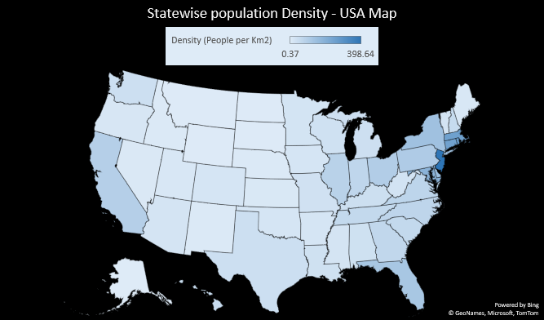
Population Density Map

Slide 7
Conclusion
The use of statistics and visualization in the fields of Data Analytics and its related networks are unprecedently becoming the go to word for all the businesses and companies.
These charts helps a person to understand better and clear about the insights drawn from the data
Excel and R are one of basic building blocks to start with and also these tools are in high in demand

Slide 8
References
https://en.wikipedia.org/wiki/List_of_U.S._states_and_territories_by_area
https://www.ssa.gov/international/coc-docs/states.html
https://simple.wikipedia.org/wiki/List_of_U.S._states_by_population_density

